Slide 1
Unit-2 DATA RATES IN MOBILE COMMUNICATION
21ECE324T-ADVANCED MOBILE COMMUNICATION SYSTEMS
Data rates in mobile communication, measured in bits per second (bps), represent the speed at which data is transmitted over a wireless network, evolving from 1G's 2 kbps to 3G's 20-100 Mbps and 4G's 100 Mbps-1 Gbps.

Slide 2
SYLLABUS-UNIT 2
Fundamental Constraints in achieving High Data Rates
Noise-limited scenarios
Interference-limited scenarios
Higher-order Modulation
Multi carrier modulation-Wider bandwidth
Spectrum Composition
Low frequency spectrum
Capacity and coverage
Spectrum for 5GNR
unlicensed mm waves bands
Terahertz spectrum, spectrum requirements for 6G: SUB-6.

Slide 3
Fundamental constraints in achieving high data rate
Fundamental constraints include limitations imposed by channel bandwidth, signal-to-noise ratio (SNR) in noise-limited scenarios, signal-to-interference ratio (SIR) in interference-limited scenarios, and the inherent trade-offs associated with using higher-order modulation techniques, where increased data rate comes at the cost of greater susceptibility to noise and interference

Slide 4
I)Noise-limited scenarios
Shannon's Capacity Theorem: This theorem defines the theoretical maximum data rate achievable on a channel with a given bandwidth and SNR, acting as a fundamental limit.
SNR requirement: To achieve high data rates in a noise-limited environment, a high SNR is necessary, meaning the signal power must significantly exceed the noise power.
Impact of higher-order modulation: While higher-order modulation can increase data rate, it also becomes more sensitive to noise, potentially limiting its effectiveness in low SNR conditions.

Slide 5
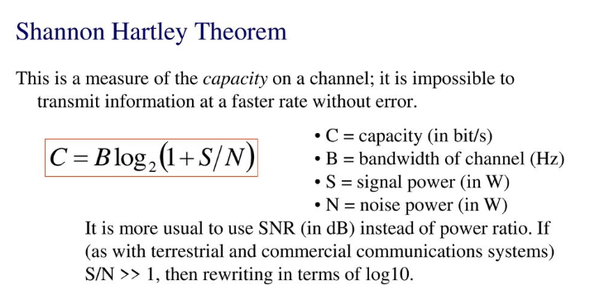

Slide 6
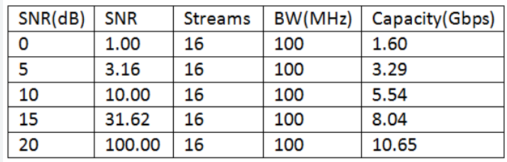
SNR vs Capacity

Slide 7


b)SNR implications
Assume communication system with a certain information rate R. The received signal power can then be expressed as
Eb is the received energy per information bit. Furthermore, the noise power can be expressed as
N0 is the constant noise power spectral density measured in W/Hz
Clearly, the information rate (R) can never exceed the channel capacity.

Slide 8


Bandwidth utilization
Bandwidth utilization (γ )= R/BW
In case of low bandwidth utilization, that is, as long as the radio link data rate is substantially lower than the available bandwidth, any further increase of the data rate requires approximately the same relative increase in the received signal power. This can be referred to as power-limited operation
On the other hand, in case of high bandwidth utilization, that is, in case of data rates in the same order as or exceeding the available bandwidth, any further increase in the data rate requires a much larger relative increase in the received signal power unless the bandwidth is increased in proportion to the increase in data rate. This can be referred to as bandwidth-limited operation

Slide 9
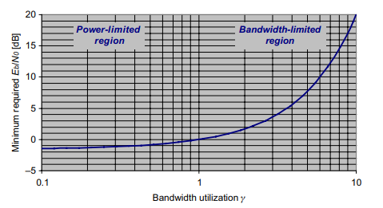
Minimum required Eb/N0 at the receiver as a function of bandwidth utilization

Slide 10
c)Impact of higher-order modulation
In order to provide higher data rates within a given transmission bandwidth the straight forward method is to use higher-order modulation, implying that the modulation alphabet is extended to include additional signalling alternatives and thus allowing for more bits of information to be communicated per modulation symbol.
In the case of QPSK modulation, which is the modulation scheme used for the downlink in the first releases of the 3G mobile-communication standards (WCDMA and CDMA2000), the modulation alphabet consists of four different signalling alternatives. These four signalling alternatives can be illustrated as four different points in a two-dimensional plane (see Figure 2.1a). With four different signalling alternatives, QPSK allows for up to 2 bits of information to be communicated during each modulation-symbol interval.
By extending to 16QAM modulation (Figure 2.1b), 16 different signalling alternatives are available. The use of 16QAM thus allows for up to 4 bits of information to be communicated per symbol interval.

Slide 11
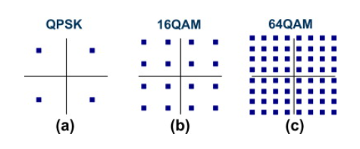
Impact of higher-order modulation (cont..)
FIGURE 2.1. Signal constellations for (a) QPSK, (b) 16QAM, and (c) 64QAM
Further extension to 64QAM (Figure 2.1c), with 64 different signaling alternatives, allows for up to 6 bits of information to be communicated per symbol interval.

Slide 12
Impact of higher-order modulation (cont..)
At the same time, the bandwidth of the transmitted signal is, at least in principle, independent of the size of the modulation alphabet and mainly depends on the modulation rate (the number of modulation symbols per second).
The maximum bandwidth utilization, expressed in bits/s/Hz, of 16QAM and 64QAM are, at least in principle, two and three times that of QPSK respectively.
The use of higher-order modulation provides the possibility for higher bandwidth utilization—that is, the possibility to provide higher data rates within a given bandwidth. However, the higher bandwidth utilization comes at the cost of reduced robustness to noise and interference.

Slide 13
II)Interference-limited scenarios
Interference management: In environments with significant interference from other signals, managing and mitigating interference becomes crucial to achieving high data rates.
SIR requirement: Similar to SNR, a high SIR is required to maintain good performance in interference-limited scenarios.
Cell-edge effects: In cellular networks, users at the cell edge often experience higher levels of interference, resulting in lower achievable data rates.

Slide 14
a)Interference management
The term “interference” is commonly used to describe the addition of unintended signals to a desirable signal. It can be caused for example by the reuse of the time–frequency resources of different base stations or user devices, or due to the unintentional leakage of a transmit signal.
Interference is one of the most dominant factors, which could lead, if not properly mitigated, to considerable performance deterioration.
Despite the inevitable advantages of all 5G key technologies, the variability and flexibility in 5G could introduce a non-orthogonality into the network and generate consequent interference. To alleviate the severe and sometimes unpredictable interference in 5G, it is critical to design efficient interference management techniques.

Slide 15
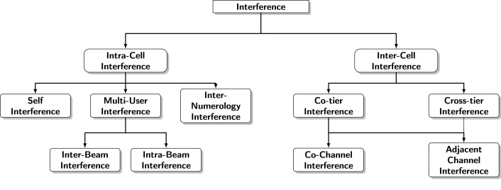
Classification of interferences in 5G
Figure 2.2 Interference Classification in 5G

Slide 16
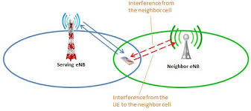
INTER CELL INTERFERENCE

Slide 17
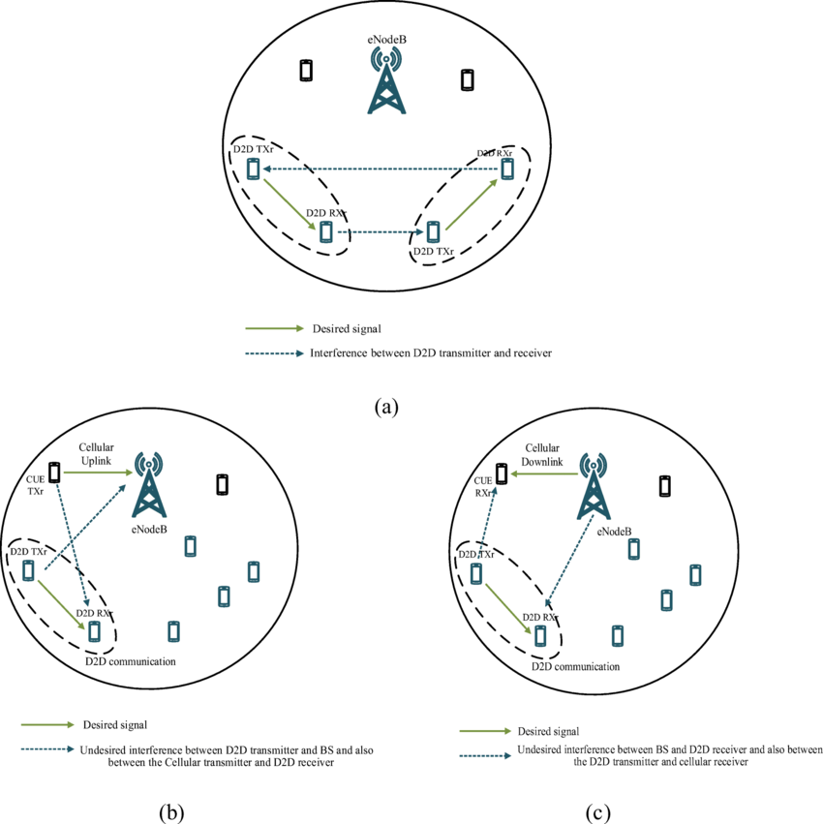
Co-tier and Cross-tier Interference:

Slide 18
Inter-cell interference (ICI)
Inter-cell interference, generally caused by using the same resources in neighboring cells, which could limit the overall network performance and degrade the signal quality of edge users. With the massive deployment of small power low-complexity BSs within the macro coverage and with the reuse of scarce spectrum resources, ICI became more and more serious.
(i) Co-tier and Cross-tier Interference: While multi-tier networks improve significantly network capacity, they face important challenges, especially in managing interference between neighboring cells. Generally, two types of inter-cell interferences may degrade the performance of heterogeneous networks: either co-tier interference between network entities in the same tier or cross-tier Interference (also called inter-tier interference) between network entities from different tiers of the network, for example, interference between SCs and MCs.

Slide 19
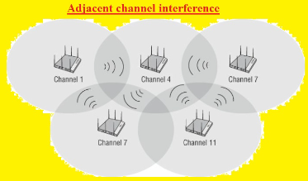
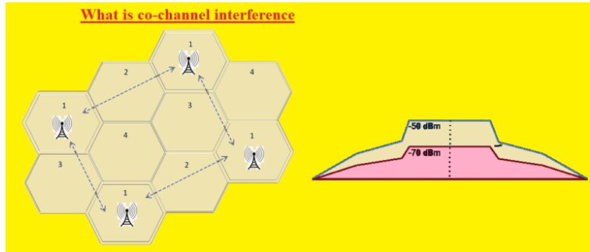

Slide 20
ii)Adjacent Channel Interference (ACI)
In general, inter-cell interference is either due to operating on the same channel which is referred to as Co-Channel Interference (CCI), or due to the overlapping between adjacent channels which is called Adjacent Channel Interference. ACI mainly occurs due to imperfect receiver filters, allowing adjacent frequencies to enter the pass-band, and to amplifiers’ non-linearity. One critical issue of OFDM networks is the high out-of-band emissions that result in important interference.
The effects of ACI can be reduced by
(i) carefully choosing the bandpass filter at the receiver,
(ii) using advanced modulation schemes and signal processing techniques,
(iii) allocating a guard band, and
(iv) allocating adjacent channels to the cells in different geographical regions.

Slide 21
(iii) Co-Channel Interference (CCI)
Co-Channel Inter-Cell Interference is the most studied interference type in the literature. In an FDD or static and perfectly synchronized TDD network, scientific research concentrates on intra-mode interference. On the other hand, inter-mode interference (or cross-mode interference) generally occurs in dynamic TDD or Full Duplex networks.

Slide 22
Intra-cell interference
The use of OFDMA (and SC-FDMA) in LTE networks made the intra-cell interference almost negligible, due to the orthogonality among subcarriers. In 5G and beyond, the multiplexing of several numerologies, the use of the same time/frequency resource to serve two or multiple users in the same cell via NOMA, SDMA, and other multiple access schemes, and the deployment of In-Band-Full-Duplex transceivers, may cause strong intra-cell interference, besides the very well known inter-cell interference.

Slide 23
(iv) Self Interference (SI)
Self Interference (SI) is also called intra-system interference
In an FD transceiver, the highly powerful transmitted signal is propagated into the local receiver through a direct path between the transmitting and receiving antennas, and through multiple reflection paths caused by the scattering of the transmitted signal by surrounding objects. These transmitted signals combine and modulate at the local receiver’s RF front-end, becoming self interference. Because it is emitted locally, this undesirable energy is billions of folds (100 dB+) higher than the intended received signal and can disrupt or even saturate the reception chain.
Self interference can be then defined as interference directly generated by the transmitter to the receiver antenna in the same device and may result in the most severe performance degradation of the receiver, compared with other interfering signals. Thus, self interference should be minimized, at most under the noise power level of the receiver. Even though self interference mostly affects full-duplex devices, transceivers that operate in FDD may also be affected by signal attenuation due to SI effects.

Slide 24
v) Multi-User Interference (MUI)
Such intra-cell interference may occur between two different beams, namely inter-beam interference, or between different users covered by the same beam, i.e., intra-beam interference.
Beamforming is a key technology in 5G cellular networks, especially in mm-wave communications. Based on Massive MIMO and using spatially narrow beam directive signals to maximize the sum of data rates, it permits the scheduling of a great number of mobile devices in the same time–frequency resource, constituting spatial division multiple access. When scheduled in the same time slots, the adjacent beams of the same cell may be overlapped to prevent coverage gaps in the angular domain and thus cause intra-cell inter-beam interference.
Furthermore, in mMIMO mm-wave systems, with large antenna array size, an additional propagation delay at each antenna element is introduced leading to a frequency-dependent variation in the beam direction, referred to as beam squinting. This important issue may further result in additional intra-cell IBI .

Slide 25
vi) Inter-Numerology Interference (INI)
In a single-numerology system such as LTE, intra-cell interference is materialized as Inter-Carrier Interference and Inter-Symbol Interference. The former defines the interference generated among subcarriers in the frequency domain, and the latter defines the interference among symbols in the time domain. However, Inter-Carrier and Inter-Symbol interferences are not sufficient to capture all the impairments incurred in a multi-numerologies system such as 5G. While the use of multiple numerologies enables high flexibility for the different services, it destroys the orthogonality principle defined for single-numerology systems, which in turn results in interference among the multiplexed numerologies, i.e., inter-numerology interference.
Recent studies show that the inter-numerology interference depends on subcarrier spacing, number of subcarriers and bandwidth within each numerology, power offset between numerologies, doppler spread, etc.
Managing the inter-numerology interference in 5G networks is definitely one of the most challenging issues. Advanced Interference Cancellation (IC) techniques and signal processing, along with adaptive resource and power allocation may reduce the INI impact.

Slide 26
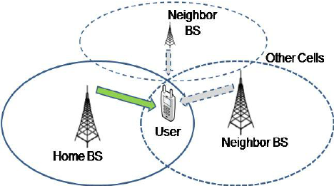
c) Cell-edge effects
Cell-edge users experience lower signal strength, higher dropped call rates, and reduced data throughput compared to users closer to the cell center.
Factors contributing to severity:
Frequency reuse factor: Higher frequency reuse factors (more cells using the same frequencies) lead to greater interference at the cell edges.
Cell size and density: Smaller cells can mitigate edge effects by reducing the distance to the interfering cells, while dense deployments can exacerbate the issue due to increased proximity of interfering signals.
Terrain and obstacles: Obstacles like buildings can further weaken the signal from the intended base station, worsening edge effects.

Slide 27
Solutions to mitigate cell-edge effects
Interference coordination techniques such as:
Cell selection: Allowing users to choose the base station with the best signal quality based on received signal strength.
Resource allocation: Dynamically allocating frequencies and power based on user location to minimize interference.
Coordinated scheduling: Coordinating transmission schedules between neighboring cells to reduce simultaneous interference.

Slide 28
III)Higher-order modulation
Increased data rate potential: Employing higher-order modulation schemes like 64-QAM or 256-QAM allows more bits to be transmitted per symbol, leading to higher data rates within a given bandwidth.
Sensitivity to noise and interference: Higher-order modulation is more susceptible to errors when encountering noise or interference, potentially causing significant performance degradation in poor channel conditions.
Trade-off between data rate and reliability: Choosing the appropriate modulation order involves balancing the need for high data rates with the requirement for robust transmission in the presence of channel impairments.

Slide 29
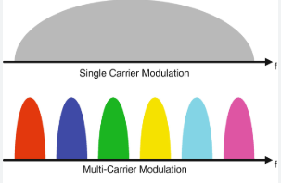
Key disadvantages of single carrier systems
Poor performance in frequency selective channels:
When a channel has significant variations in attenuation across different frequencies, a single carrier signal can be severely distorted, leading to poor data reception.
Complex equalization required:
To mitigate the effects of channel distortion in a single carrier system, complex equalization filters are needed, which can be computationally intensive and increase system complexity.
Limited bandwidth efficiency:
Single carrier systems may not efficiently utilize the available bandwidth, especially when dealing with varying channel conditions across the entire frequency band.

Slide 30
Need for multicarrier systems
Improved resilience to channel impairments:
By dividing the data into multiple subcarriers, each experiencing different channel characteristics, multicarrier systems can adapt to frequency selective fading and minimize signal distortion.
Simplified equalization:
Since each subcarrier experiences a relatively flat channel, equalization in a multicarrier system is significantly simpler, reducing computational complexity.
Enhanced bandwidth efficiency:
Multicarrier systems allow for efficient allocation of subcarriers based on channel conditions, maximizing data rate within the available bandwidth.

Slide 31
Multi Carrier Modulation (MCM) Techniques
Multicarrier modulation (MCM) is a form of frequency division multiplexing (FDM), where data are transmitted in several narrowband streams at different carrier frequencies. However, unlike conventional FDM systems, where the narrowband subcarrier signals are separated by guard bands in the frequency domain, MCM systems allow for overlapping adjacent subcarriers when a certain set of conditions (orthogonality conditions) are satisfied.
MCM is one of the data transmission methods which transmit data across different carriers which are typically near to each other.
It has several benefits that include resistance to narrow band fading, interference immunity and multipath effects.
It is extensively employed for data transmission because this has been a spectral efficient technique and robust signal waveform to real-world channel environments

Slide 32
Types of MCM
The three main types of multi-carrier systems are:
Orthogonal Frequency Division Multiplexing (OFDM),
Filter Bank Multi-Carrier (FBMC), and
Universal Filtered Multi-Carrier (UFMC);
where OFDM is the most widely used, while FBMC and UFMC offer improved spectral efficiency with more complex filtering techniques to mitigate spectral leakage issues compared to OFDM.

Slide 33
Orthogonal Frequency Division Multiplexing (OFDM)
In OFDM technique, data is carried by large number of orthogonal subcarriers that are closely spaced. Although sidebands from each carrier overlap, sub-bands receive data with no interference because they are orthogonal to each other.
OFDM transmitter and receiver system block diagram is presented in Fig. 2.6.
Serial to Parallel converter transforms serial binary input data to parallel binary data.
The IFFT block receives parallel data. By maintaining the orthogonality of the OFDM with IFFT, the parallel data is transformed into a time domain signal.
Cyclic Prefix (CP) is appended to IFFT block for synchronization.

Slide 34
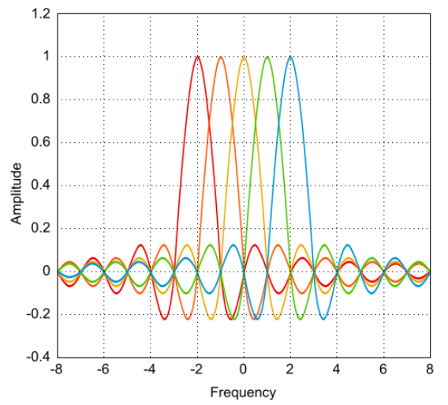
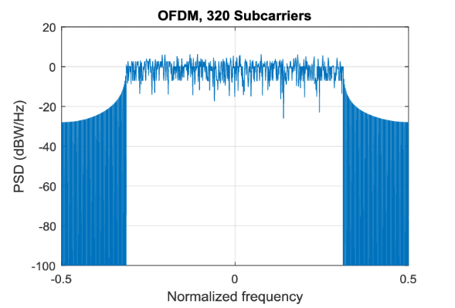
OFDM

Slide 35
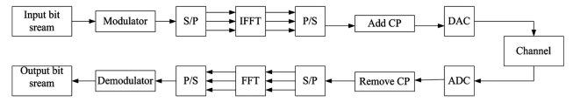
Orthogonal Frequency Division Multiplexing (OFDM)
Fig. 2.6 — OFDM transmitter & receiver
In 5G very large wireless data rate connectivity upto 10 Gb/s and reduced latency. These applications cannot be implemented by OFDM technique. Hence the new techniques such as UFMC and FBMC have been introduced

Slide 36
Filter Bank Multicarrier (FBMC)
FBMC transceiver block diagram is presented in Fig. 2.7.
OFDM has the similar principle of operation except cyclic prefix is replaced by Poly Phase Network (PPN).
PPN technique adds a set of digital filters with fewer computations.
Orthogonality must be ensured for all carriers in OFDM, whereas FBMC only requires orthogonality for neighboring sub-channels.
Without an OFDM cyclic prefix, the arrangement of filter banks through OQAM modulation leads highest bit rate.

Slide 37
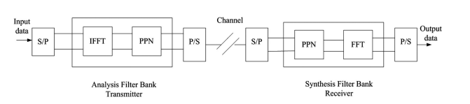
Filter Bank Multicarrier (FBMC)
Fig. 2.6 — FBMC transmitter & receiver
N numbers of input signals are utilized to generate N numbers of outputs using array of N numbers of filter processes.
If the inputs of these N filters are connected, based on each filter characteristics, the system can be considered as an analyzer to the input signal and this type of filter bank is called Analysis Filter Bank (AFB).
When filter array is considered with added outputs then a distinct signal is synthesized, and this filter bank is named as Synthesis Filter Bank (SFB).

Slide 38
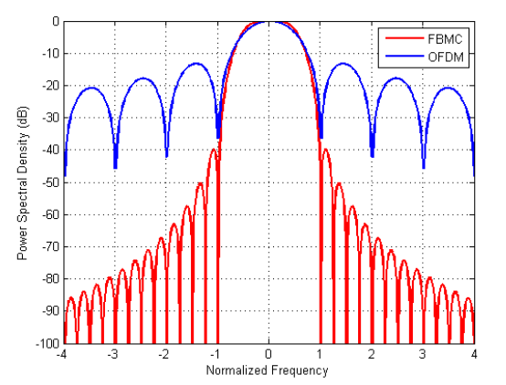
FBMC

Slide 39
Universal Filtered Multi Carrier (UFMC)
The UFMC transmitter and receiver block diagram is presented in Fig. 2.8. Here, the overall bandwidth has been divided into a few sub-bands first. Every sub-band has some number of subcarriers.
Data bits are given to each sub-band. After that the data bits are given to symbol mapper which assigns symbols to bits. The S/P converter transforms the data bits to parallel. The output of S/P converter is given to N-point IFFT. Here the IFFT function as a modulator. It is very difficult to design modulators for each and every subcarrier.
The IFFT output is serialized by using a P/S converter, and the output is filtered with a Chebyshev filter of length L.26 The output of each filter is added, and the filter output is transmitted through the channel.

Slide 40
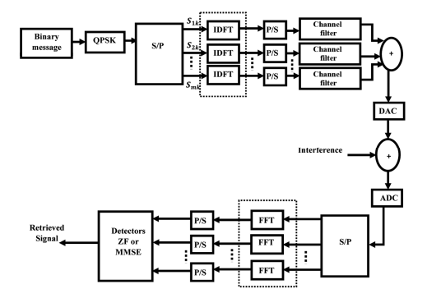
Universal Filtered Multi Carrier (UFMC)

Slide 41
Universal Filtered Multi Carrier (UFMC)
The received data from the channel is fed into the S/P converter and then demodulated after passing through the 2N-point FFT. After that the output of FFT is given to frequency domain equalizer per subcarrier.
The output of equalizer is given to Parallel to Serial (P/S) converter which converts all the parallel data streams into single stream. The single stream is passed through symbol demapper that transforms the symbols to bits and original data is retrieved.
UFMC has higher spectral efficiency compared to OFDM because of the absence of cyclic prefix insertion as in case of OFDM. It uses the entire spectrum because there is no repetition of the same bits. UFMC has fewer side lobes than OFDM and FBMC which in turn decreases the interference on adjacent subcarriers.

Slide 42
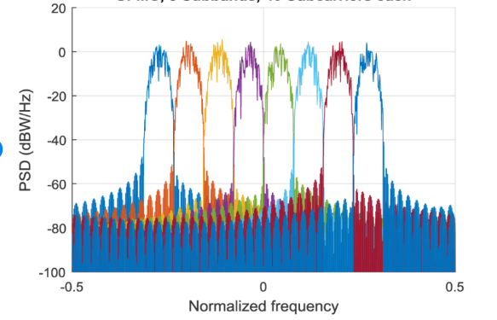
UFMC

Slide 43
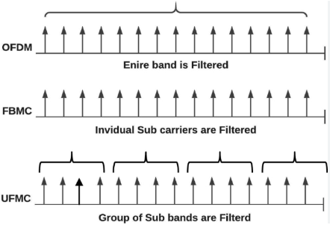
Filtering in MCM

Slide 44
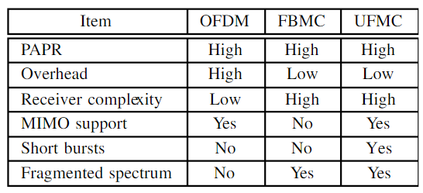
Comparison between OFDM, FBMC, and UFMC systems

Slide 45
Other MCM methods
Apart from OFDM, FBMC, and UFMC, other examples of multi-carrier modulation techniques include:
GFDM (Generalized Frequency Division Multiplexing)
Offers flexibility in pulse shaping by allowing non-rectangular pulses, which can improve spectral confinement compared to OFDM.
2. BFDM (Bi-Orthogonal Frequency Division Multiplexing)
Utilizes bi-orthogonal waveforms for improved spectral efficiency and reduced inter-carrier interference.
3. DMT (Discrete Multitone)
Primarily used in ADSL applications, where the power allocation across subcarriers can be dynamically adjusted based on channel conditions.
4. WMC (Wavelet Multi-Carrier)
Leverages wavelet transforms for efficient signal representation, potentially providing better performance in channels with time-varying characteristics.

Slide 46
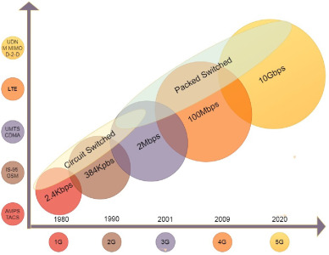

Slide 47
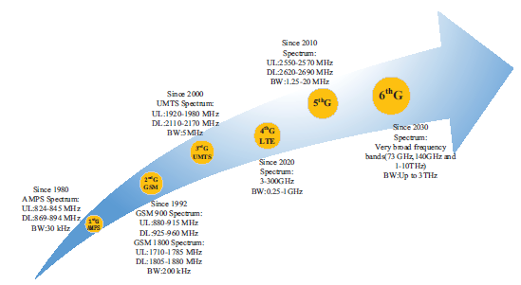
Spectrum Composition
Our society will become data-led due to almost no time-delay wireless connections by around 2030. Therefore, 6G will be expected to be used to promote the development of the wireless technology we are familiar with today. And it will be expected to achieve a quite good system performance. Fig. (2.3) presents a synopsis of the evolving wireless cellular communication generation.
Fig 2.3 Spectrum compositions of mobile communication systems

Slide 48
Spectrum Composition
In order to increase the data rate 100 to 1000 times faster than 5G in terms of frequency spectrum, 6G may use a higher frequency spectrum than previous generations as a vision for the future.
4G and the previous mobile communication systems all use the Sub-6 GHz frequency band, while the 5G mobile communication system uses both the Sub-6 GHz frequency band (FR1 band, 450 MHz-6 GHz) and the 24-100 GHz frequency band (FR2 band, 24.25 GHz-52.6 GHz). Researchers realize that although 5G expands the spectrum bandwidth, the current frequency band is still not enough to meet the increasing demand for communication services in the rapidly developing human society. Therefore, in the study of 6G networks, we will consider spectrum resources above 100 GHz such as millimeter wave (mmWave) and terahertz (THz) to increase the transmission bandwidth.
The 6G wireless communication system will use multi-band and high-spread spectrum to increase the transmission rate. The ultimate vision is to make the endto- end transmission rate reach hundreds of gigabits. It is expected that in the future 6G, the ground mobile communication network, satellite system, and Internet will merge into a large space-air-ground-sea network. Thus, 6G spectrum needs to support space-air-ground-sea integrated communications. Most operating frequencies for space-air-ground-sea communications are assigned by the International Telecommunication Union (ITU). The mmWave bands can be used in both space-ground and air-ground channels as well as space-air transmission.
SUB-6
Sub-6 GHz bands have been the primary working frequency in the third generation, 4G, and 5G due to wide coverage capabilities and low cost, which are indispensable in 6G

Slide 49
The Low Frequency Spectrum
The development of 5G not only requires a large amount of spectrum resources, but also requires high, medium and low frequency collaborative work. The World Radio Communication Conference in 2019 (WRC-19) reached a global consensus on the 5G millimetre-wave frequency band to meet the business needs of 5G systems for ultra-large capacity and high-speed transmission.
At the same time, in order to solve the problem of large-scale and deep coverage for 5G systems and achieve a better balance between network capacity and coverage, many countries are focusing on continuous 5G spectrum in the middle and low frequency bands. The new IMT (5G or 6G) usage rules for the 6GHz (5925 MHz-7125MHz) frequency band was included in the agenda of WRC-23 with the vigorous promotion of the Chinese delegation at the WCR-19.6425 MHz-7025 MHz becoming a new regional (Arab countries, Africa, Europe, CIS countries) IMT frequency band and 7025 MHz-7125 MHz becoming a new global IMT frequency band are being investigated.
Spectrum resources are precious and scarce as the core resource for the development of mobile communication technology. Spectrum planning is the starting point of the industry and will also determine the development direction, rhythm and pattern of the industry. The successful establishment of the new allocation of IMT for the 6 GHz spectrum means that the 6 GHz frequency band will become a potential frequency band for IMT (5G or 6G).
Countries around the world will give priority to this frequency band when they build 5G systems and future 6G systems, which promotes the research and development of IMT technology for 6 GHz band and the internationalization of the industrial chain and accelerates the process of 5G global commercial and 6G research and development.

Slide 50
Capacity and Coverage
5G new business applications have driven rapidly increasing in mobile data usage with the further acceleration of 5G commercial use. And enhanced mobile broadband services, fixed wireless broadband services and industrial applications such as smart cities and industrial manufacturing have accelerated the surge in mobile data usage. According to an industry analysis report, data usage per user per month in some leading markets will reach 150 GB in 2025. This requires a large amount of radio spectrum to support undoubtedly. The low and medium frequency bands can provide continuous bandwidth on the order of 100 MHz and good network coverage compared with the millimeter wave frequency band.
Furthermore, the performance requirements of network capacity and coverage can be taken into consideration, and network construction costs can be greatly reduced. In addition, the propagation characterization and channel models in Sub- 6 GHz bands have been extensively investigated in 5G. Therefore, they are important parts of the 5G or 6G spectrum. As one of the pioneers in the development and deployment of 5G systems, China’s radio management department has been committed to seeking more IMT frequency resources for 5G or future 6G technologies to support its future technologies and applications from the perspective of efficient frequency use and long-term planning.
According to the characteristics of each frequency band, the Sub-6 GHz spectrum will take into account the requirements of coverage and capacity, which is an ideal compromise between peak rate and coverage capability. The frequency spectrum above 6GHz can provide ultra-large bandwidth, larger capacity and higher speed, but the continuous coverage capability is insufficiently shown in theFig. 2.4.

Slide 51
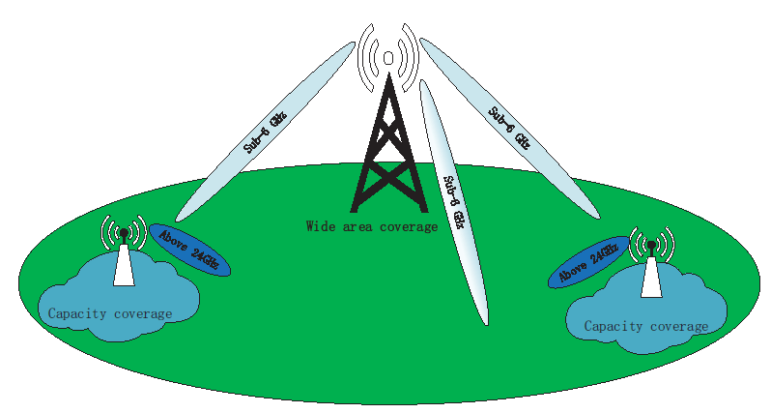
Fig. 2.4. Coverage of frequency bands.

Slide 52
Capacity and Coverage (contd..)
5G wireless infrastructures for Sub-6 GHz will be widely deployed using a beamforming solution, which can greatly expand network coverage and penetration capabilities within buildings. Low frequency bands (such as 600 MHz, 700 MHz, 800 MHz, 900 MHz, 1.5 GHz, 2.1 GHz, 2.3 GHz and 2.6 GHz) have the characteristics of wide coverage and low cost, which are used the largescale IoT in the future, the industrial automation and the key task IoT.
Wireless throughput and capacity will show explosive growth with the mobile networks continuing to accelerate. The above 24GHz mmWave beamforming is also considered as a promising technology to provide ultra-high capacity in 6G coverage.

Slide 53
The Spectrum Allocation of Sub-6
Spectrum for 5G NR
The spectrum resource from 1.7 GHz to 4.7 GHz is the Sub-6 GHz spectrum allocated to 5G NR by 3GPP, which is the FR1 band, and the maximum continuously allocated spectrum is 100 MHz. The following is an introduction to several major FR1 bands. n77 (3300 MHz-4200 MHz) and n78 (3300 MHz-3800 MHz) are currently the most unified frequency bands for 5GNR in the world. n79 (4400 MHz-5000 MHz) is also used in 5G NR mainly promoted by China, Russia and Japan. n28 (700 MHz) is also highly valued because of its good coverage. This frequency band has been identified as a pioneer candidate frequency band for global mobile communications at WRC-15.
If this frequency band cannot be fully utilized, it would be a pity. At present, the US operator T-Mobile has announced the use of n71 (600 MHz) to build 5G. The use of the 3.4 GHz-3.8 GHz band areas is the most complicated. For example, in the United States, the 3.5 GHz frequency band is used for Citizen Broadcast Radio Service (CBRS), while 150 MHz of the frequency spectrum is used for radar communications. In addition, the frequency band can also be used for other commercial services using dynamic access. This dynamic access method saves users from expensive spectrum licenses, only needs to pay the corresponding communication fees to the service provider.

Slide 54
Spectrum Selection of Systems
License-free frequency band technology simplifies the process and restrictions for users to connect to the network. Nevertheless, due to the existence of these unlicensed spectrum users in the network, the reliability and security of the wireless network will be disturbed. In the Sub-6 GHz spectrum area, the most noteworthy unlicensed spectrums are
the 2.4 GHz and 5 GHz bands, which are currently the two frequency bands with the highest utilization rate. Among them, bandwidth resources in the 2.4 GHz band are scarce and have been pre-empted by existing services, making it very crowded. Compared with 2.4 GHz, the available frequency of the 5 GHz band is wider. But with the development of wireless communication networks, it is expected that the 5 GHz band will also be taken up in the next few years. And the current 5 GHz band is divided into several parts by different wireless access methods, which cannot be used uniformly.
Because the spectrum resources used by wireless communication networks and radar systems overlap, the Dynamic Frequency Selection (DFS) mechanism is required by the FCC and ETSI to be used in the Sub-6 GHz band to avoid interference to the radar system. And most of the access methods for the available spectrum in the low-frequency band are the Listen Before Talk (LBT). LBT will cause a large amount of delay idle periods in the use of spectrum, resulting in low spectrum utilization, which is the major resistance to the low-latency vision of 5G networks.
Recently, FCC has promoted additional spectrum for unlicensed usage in the 5.925 GHz - 7.125 GHz range. This is commonly referred to the 6 GHz band, and its regulations are currently been defined. The current trend of extending the availability of unlicensed access, even in the below 10 GHz spectrum region, copes with the necessity of dealing with the spectrum crunch due to the exponential increase of wireless applications. Unlicensed access also eliminated the obsolete licensing paradigm that is known to lead to inefficient spectrum utilization.

Slide 55
Why mmWAVE
It is known that the target data rate of Sub-6 GHz 5G mobile communications is Gbps level, and the target data rate of 5G mmWave is about 10 Gbps. There are two key ways to increase the wireless transmission data rate: one is by improving the spectral efficiency and the other is by using large frequency bandwidth or spectrum resource

Slide 56
6G mmWave Communication
Advantages of mmWave
The millimeter wave (mmWave) communication is a prominent candidate for next generation of wireless communication systems by virtue of its large bandwidth, low latency, high rate, and friendly positioning function. The mmWave band is usually defined as electromagnetic waves in the 30GHz-300GHz frequency domain. It is located in the overlapped wavelength range of microwave and far-infrared waves, so it has the characteristics of both spectrums. Since its wavelength is 1ms-10ms, it is called the millimeter wave.
Since the development of the Internet, the democratization of information has improved education, e-commerce has promoted economic growth, and business innovation has been accelerated by supporting broader cooperation. And now we are entering an era of the Internet of Everything (IoE) integrating billions or even trillions of connections.
The large bandwidth and high speed that mmWave can bring make it possible for businesses such as high-definition video, virtual reality, augmented reality, dense urban information services, factory automation control, and telemedicine. It can be said that the development and utilization of mmWave provides a broad space for 5G applications on the basis of Sub-6 services.

Slide 57
Challenges in mmWave communication
But there is a huge disadvantage that mmWave has serious attenuation during propagation compared with other frequency bands. And because of its large available bandwidth, the original resolution of mmWave communication systems is smaller than that of traditional low-band communication systems. Therefore, mmWave has not appeared in the field of mobile communication for a long time.
Qualcomm prescribes the two solutions.
Firstly, it uses multi-beam technology to address mobility challenges and improve coverage, robustness and non-line-of-sight operation.
Secondly, it uses path diversity to deal with blocking problems, and uses terminal antenna diversity to improve reliability. Finally, several indoor and outdoor OTA tests were carried out to verify mobility. Therefore, the application of mmWave in mobile phones is realized.

Slide 58
Unlicensed mmWave Bands
In the 60GHz mmWave frequency band, about 7 GHz bandwidth is available for unlicensed access, which is much larger than the unlicensed spectrum of sub-6GHz. In such a wide available spectrum, to achieve the peak transmission rate of 100 Gbps required by the 5G network, at least a spectrum utilization rate of 14 bit/Hz per unit time is required.
However, the existing data modulation/demodulation technology and related original devices cannot meet such strict spectrum utilization and symbol fidelity.
Consequently, one of the current research difficulties in the field of wireless communication systems is how to achieve a transmission rate of 100 Gbps in a high-frequency band above 100 GHz.
For example, the FCC decided to open up four mmWave frequency bands above 95 GHz in the United States in 2019.

Slide 59
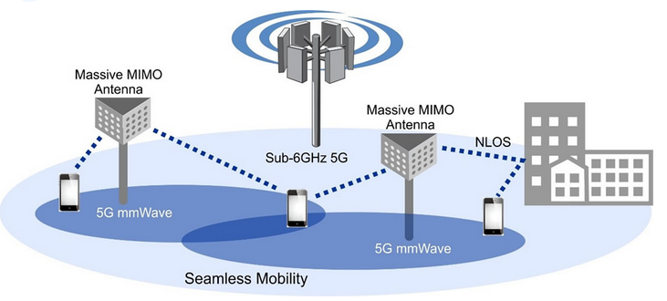

Slide 60
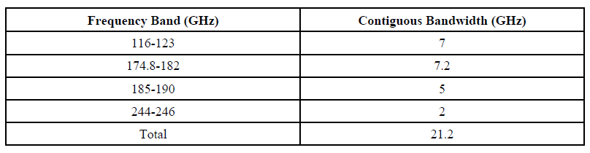
As shown in Table 1, a total of approximately 21 GHz bandwidth is provided for license-free access.
Table 1. Unlicensed mmWave bands.

Slide 61
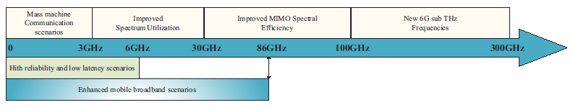
Spectrum Options for 6G
The 26 GHz-100 MHz frequency band is a big opportunity for mobile networks. However, it is the previously unpopular feature of mmWave that makes it very suitable for 5G. It relies on the use of micro-infrastructure, such as small units distributed in dense urban locations.
5G needs to use a wider spectrum than previous generations of mobile systems. According to this trend, it is expected that a higher frequency spectrum will be used in 6G wireless communication networks.
Therefore, we initially set a 6G system to be deployed in the sub-terahertz band of 114 GHz-300 GHz as shown in Fig. 2.4.
Fig. 2.4 Spectrum options for 6G.

Slide 62
Spectrum Options for 6G (contd)
According to its ultrahigh frequency physical characteristics, the sub-terahertz spectrum can complete ultra-narrow beam transmission, thereby improving spectrum efficiency and performing precise positioning. This allows the sub-terahertz band to perform well in scenarios such as future backhaul networks and real-time short-distance communications.
On the other hand, It is predicted that the number of mobile devices worldwide will be more than 125 billion in the 2030s, including the mobile phone, tablet, wearable devices, integrated headsets, implantable sensors and other machine type users. The Internet of Thing (IoT) system, connecting millions of people and billions of devices, will be one of the essential application scenarios for mmWave B5G and 6G.

Slide 63
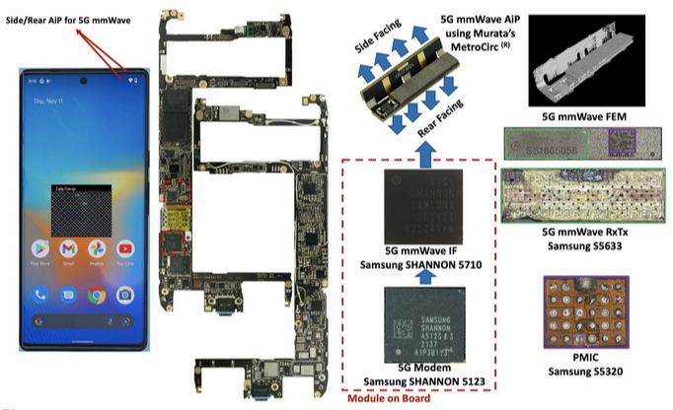
Google Pixel 6 pro

Slide 64
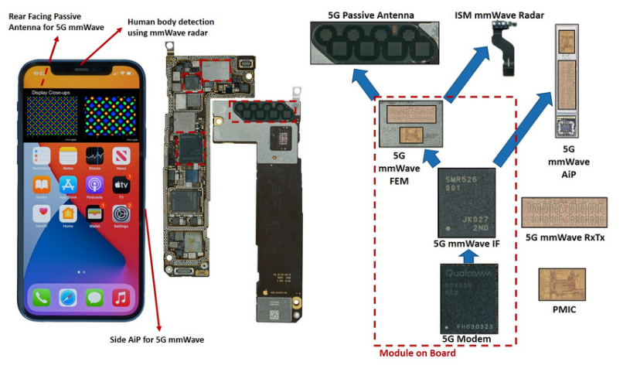
Iphone 12 5G

Slide 65
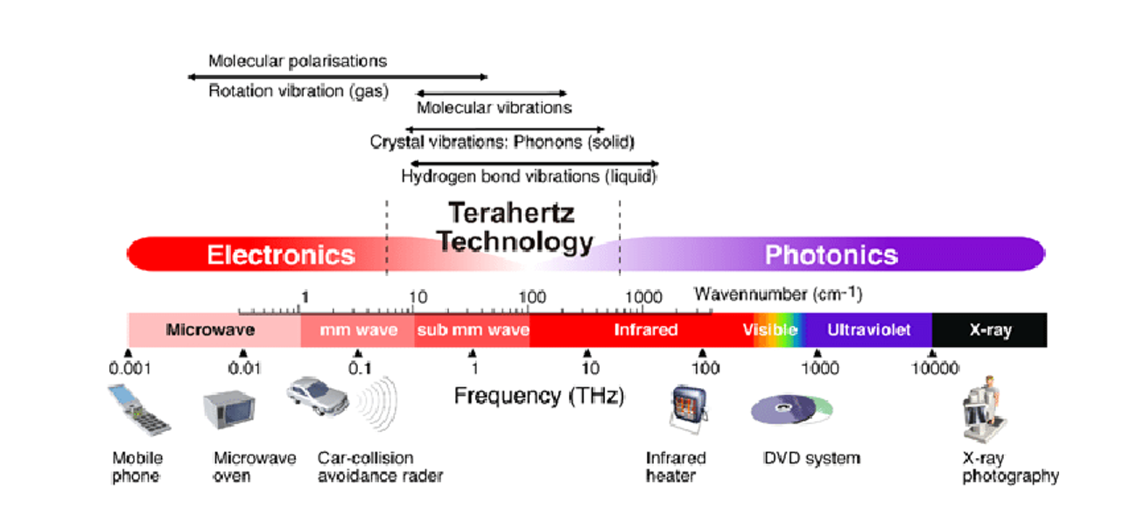
Potential for High Speed:
The THz band offers a large bandwidth, enabling potentially much faster data transmission rates than current wireless technologies.
6G and Beyond:
THz communication is considered a key technology for future wireless networks, including 6G and beyond, to meet the growing demand for higher bandwidth and faster data rates.
Terahertz (THz) communication uses electromagnetic waves in the 0.1 to 10 THz frequency range for ultra-high-speed data transmission, holding promise for 6G and beyond applications, including ultra-fast internet, and advanced sensing applications.

Slide 66
Terahertz (THz)
As the propagation medium of wireless mobile communication systems, spectrum resources will become increasingly scarce as the types and demands of communication services continue to develop.
At the beginning of 5G research and development, there have been suggestions to seek scalable spectrum resources in the direction of terahertz and visible light.
Terahertz is a new radiation source with many unique advantages. It has a wide range of applications in many fields, such as semiconductor materials, tomography technology, label-free genetic examination, broadband communications, and microwave orientation.
The study of radiation sources in this frequency band will not only promote the major development of theoretical research but also pose major challenges to solid-state electronics and circuit technology.
The development and utilization of terahertz spectrum in fields such as communications have been highly valued by Europe, the United States, Japan and other countries and regions. And they have also received strong support from the ITU.

Slide 67
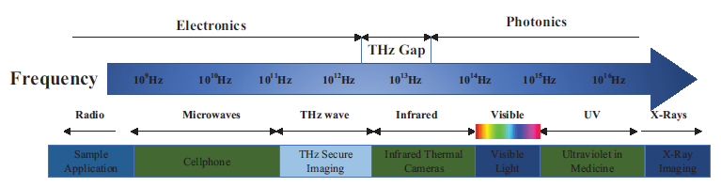
6G Terahertz Communication
Fig. 2.5 Spectrum of mmWave and terahertz.
With the development of science and technology, the communication volume and connection volume of wireless services are increasing explosively. Especially since the 5G era, the rapid development of wireless communication technologies in space and sky fields has made 2-dimensional wireless channel performance analysis no longer applicable. In the 6G network, we need to perform three dimensional modeling of the wireless channel and calculate the relevant performance parameters in the unit cubic space, which requires a wider RF spectrum bandwidth.

Slide 68


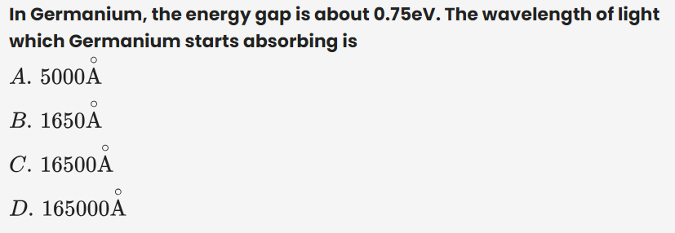
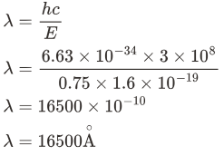
Relation of the wavelength with respect to the energy gap
h is the Planck’s constant,
c is the speed of light in free space,
λ is the wavelength of the light.

Slide 69
Terahertz Spectrum
The frequency spectrum is a physical quantity existing in nature, which cannot be increased or decreased, so it is extremely precious.
Terahertz waves refer to electromagnetic waves with frequencies in the range of 0.1THz-10 THz, between millimeter waves and infrared light as shown in Fig. 2.5.
It is the transition zone from macroscopic classical theory to microscopic quantum theory, as well as the transition zone from electronics to photonics, called the terahertz gap of the electromagnetic spectrum.

Slide 70
Terahertz Spectrum (contd)
The commercial application of terahertz technology did not seem clear enough a few years ago. However, the terahertz measuring instruments showed great market potential in 2018. Civil safety applications, non-destructive testing and industrial quality control can all benefit from the application of the terahertz systems.
Traditionally, the 26.5–300 GHz frequency band is defined as the mmWave band and 300–10000 GHz as the THz band. In recent years, however, the definition of 100–10000 GHz (or 0.1–10 THz) as the THz band has been commonly accepted.
With the critical growth of wireless communication, THz frequency bands have been envisioned as a promising candidate to supply sufficient spectrum resources for near future 6G.
Specifically, the terahertz band can be up to four orders of magnitude higher than the existing microwave communication, which means that it can carry a larger amount of information.
Also, terahertz integrates the advantages of microwave communication and optical communication, with many characteristics such as high transmission rate, large capacity, strong directionality, high security, and good penetration. Enabled by these obvious advantages, extensive researches of THz communication have been developed worldwide.

Slide 71
Advantages of Terahertz
1. Terahertz wave is more suitable for high-speed short-range wireless communication because it is easily affected by moisture in the air when it propagates, causing serious signal attenuation.
2. Terahertz waves have narrow beams, good directivity and strong anti-interference capabilities. Therefore, secure communication within 2-5 km can be realized using terahertz waves.
3. The high frequency and wide bandwidth physical characteristics of terahertz can meet the ever-increasing demand for wireless communication capacity. The terahertz spectrum has a usable spectrum bandwidth of tens of GHz between 108-1013 GHz, which can provide a rate exceeding Tbit per second.
4. In terms of space communications, there are relatively transparent atmospheric windows near the 350, 450, 620, 735 and 870 μm wavelengths of terahertz waves shown in Fig. 2.6, which can achieve lossless transmission. Very small power can complete long-distance communication. Moreover, the receiving terminal is easy to align because the terahertz wave beam is wider compared with wireless optical communication. The quantum noise is lower and the antenna can be miniaturized and planar. Therefore, terahertz waves can be widely used in space communications and are particularly suitable for wideband communications such as satellite communications and satellite-to-ground communications.

Slide 72
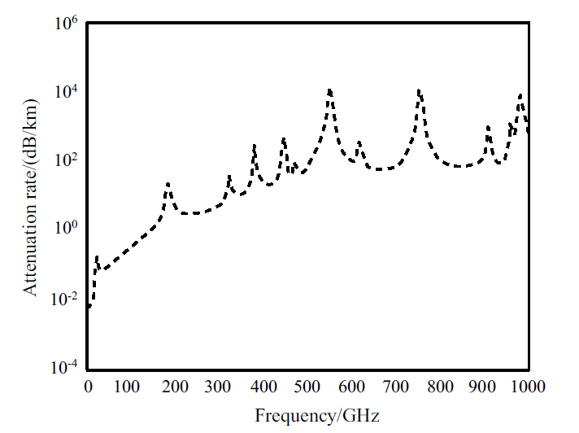
Attenuation rate of terahertz
Fig. 2.6. The attenuation rate of terahertz.

Slide 73
Advantages of Terahertz (contd)
5. The terahertz band is also suitable for Massive MIMO with more antennas (the same size or even smaller antenna volume compared to millimeter waves) because of a short wavelength. Preliminary research shows that the beamforming and spatial multiplexing gain provided by Massive MIMO can well overcome the rain fading and atmospheric fading of terahertz propagation, which can meet the coverage requirements of dense urban areas such as the cell with a radius of 200 m.
6. Due to the low photon energy of terahertz waves, compared with wireless optical communication, terahertz waves as information carriers have the advantage of high energy efficiency.
7. Terahertz has a very short wavelength, has a high time-domain spectrum signal-to-noise ratio, can penetrate walls with a small attenuation, and is an ideal technology for imaging through walls in complex environments.

Slide 74
Challenges in the Terahertz Bands
1. Communication distance: Due to the short wavelength and high frequency of terahertz, it has a larger free space fading than low-frequency bands. In addition, the existing communication mechanisms may not be suitable for the highly directional propagation characteristics of terahertz.
2. Large-scale fading: Shadows have a non-negligible effect on the transmission of terahertz radio signals with ultra-high frequencies. For example, after a terahertz signal passes through the human body, its signal is attenuated by at least 20 dB, and after passing through a brick wall, its signal attenuation can even be as high as 80 dB. However, because humidity/rainfall fading is mainly for radio signals with frequencies sub-100 GHz, the terahertz band above 100 GHz has less impact.
3. Fast channel switching and disconnection: The channel coherence time has a linear relationship with the carrier frequency for a given moving speed. Therefore, because the coherence time is very small, terahertz has a greater Doppler shift, and higher shadow fading leads to significant path loss, which ultimately makes terahertz communication have the problems of frequent frequency band switching and severe fluctuate. Also, terahertz technology is mainly used for covering high-directional communication in a small area. This signifies that path fading, serving beams, and cell association relationships will change rapidly. we need to design a new rapid adaptive communication mechanism from a system perspective.
4. Energy consumption: A major difficulty in using ultra-large-scale antennas is the energy consumption of broadband terahertz system analog/digital conversion. Power consumption generally has a linear relationship with the sampling rate and an exponential relationship with the number of samples per unit. The wide bandwidth of the terahertz frequency band and the large number of antennas require high-resolution quantification. Therefore, it will be a huge challenge to implement low-power and low-cost devices.

Slide 75
Related Technology for Terahertz Communication
1. Semiconductor technology, including RF, analog baseband and digital logic, etc.;
2. Research low-power high-speed baseband signal processing, corresponding low-complexity integrated circuit design, and high-speed communication baseband platform based on terahertz;
3. Terahertz modulation/demodulation technology, including direct modulation, mixing modulation, and photoelectric modulation, etc ;
4. Waveform and channel coding;
5. Synchronization mechanism, for example, tracking and synchronization technologies of hundreds of orders of magnitude antenna elements in dense access scenarios;
6. Channel measurement and modeling of terahertz space and terrestrial communication
In addition, the ITU has decided to assign 0.12 THz and 0.2 THz to the new generation of mobile communications in terms of spectrum supervision. However, the regulatory rules for the band exceeding 0.3 THz have not yet been unified globally. The ITU level and the WRC meeting need to work together and actively promote to reach a consensus.

Slide 76
Thank you

